Slide 1
Dual Sparse Attention Network For Session-based Recommendation
汇报人：Gu Tang
时间：2021.3.30
Meeting:2021 AAAI
Code: https://github.com/SamHaoY uan/DSANForAAAI2021

Slide 2
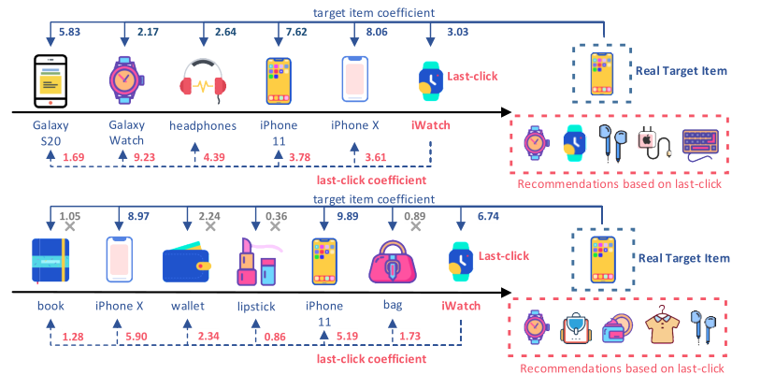
Motivation

Slide 3
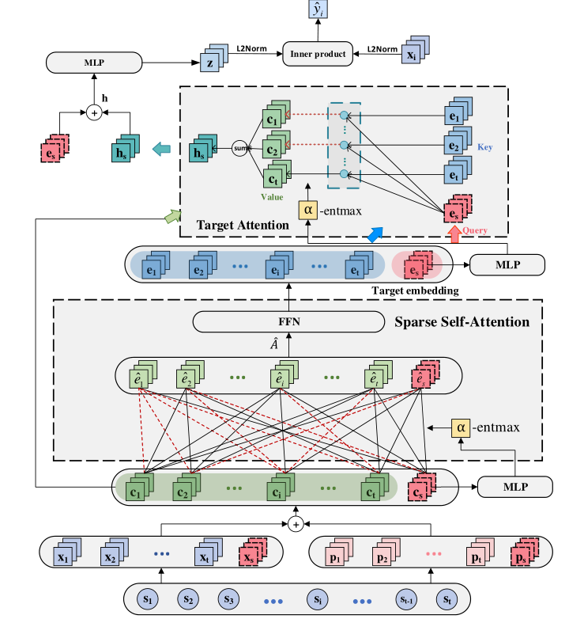
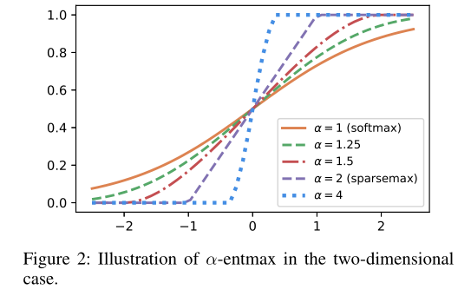
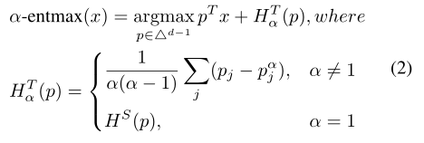
Model Architecture

Slide 4
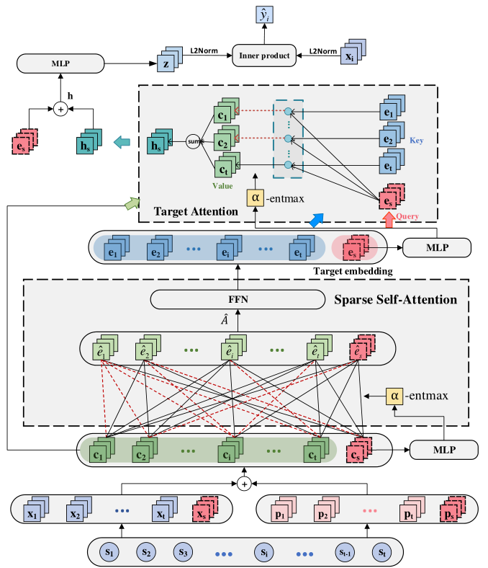
Model Architecture

Slide 5
Experiment

Slide 6
Experiment

Slide 7
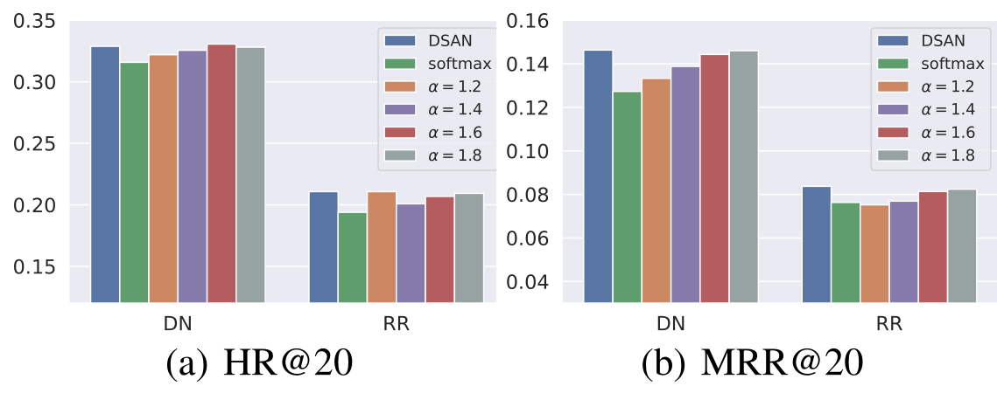
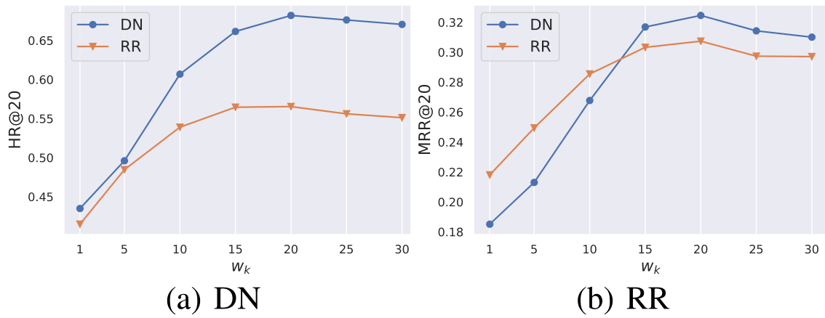
Experiment

Slide 8
THANGKS!

